Slide 1
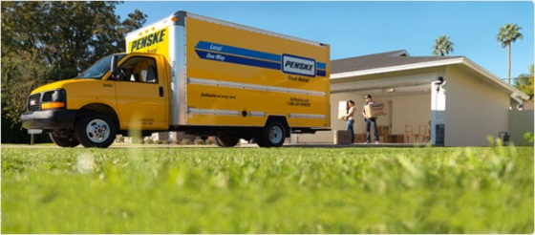
PREMIER LOGISTICAL CENTER
Fort Hood & Truck Center Seeking Assistant Sales Clerk that is responsible, organizing and coordinating office operations and procedures in order to ensure organizational effectiveness and efficiency. Military Spouse and Dependents preferred but not mandatory.
SME’S
SHIPPING & MOVING
MOVING BOXES
PACKING MATERIALS
866-697-3501
premiergroup1@hotmail.com
plchdq@gmail.com
Bldg 87030 Old Ironside & Martin Drive.

