Slide 1


Soldier and Family Assistance Center
Medical Separation & Retirement
Transitions Briefing
Army Community Service (ACS) Center
6303 WETZEL AVE., BLDG 1526
Website: www.carson.army.mil/acs
Hours:
Monday – Friday: 8 a.m. to 4:30 p.m.
Wednesday: 9 a.m. to 4:30 p.m.
*Closed on Weekends, Federal Holidays, and some training holidays.

Slide 2
SFAC Staff
Shawn Cannon
Office: 719-524-0148
Gov Cell: 719-726-8134
Email: shawn.m.cannon.civ@army.mil
Stephen Grijalva
Office Phone: 719-526-5807
Gov Cell 719-725-8808
Email: stephen.c.grijalva.civ@army.mil

Slide 3
TERMINAL LEARNING OBJECTIVES
Develop an understanding of the IDES Process and Separation from Ft. Carson
Bring awareness to the SFAC resources available and the role of the SFAC Staff
Comfortable understanding of how to apply or register for services upon separation
Address concerns openly or privately with SFAC Staff
Notes:
1. Explain the IDES process. 2. Explain medical retirement and med separation 3. Explain the 2 types of retirement 4. Explain the 4 types of VA 100%

Slide 4




SFAC PARTNERS
https://www.woundedwarriorproject.org
https://www.doi.gov/veterans/operation-warfighter
https://warriorcare.dodlive.mil/Care-Coordination/Education-Employment-Initiative/
E2I
Notes:
1. Explain the different partners and what the do for the soldiers in the IDES

Slide 5

Completion of TAP is Congressionally mandated; you will not be allowed to final out until you have completed this program.
Transition Assistance Program (TAP), Bldg. 6237, 526-0410. Retiring Soldiers are eligible to receive services for life. MEB/IDES separating Soldiers (eligible for services for 180 days post separation).
SFAC TAP Counselor:
Ms. Christina Hillard 719-524-7310
Christina.Hillard.ctr@army.mil

Slide 6
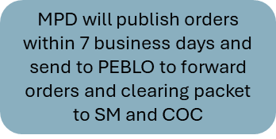
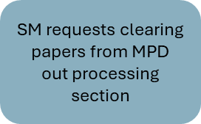
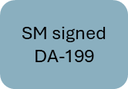
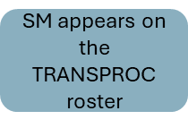
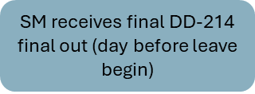
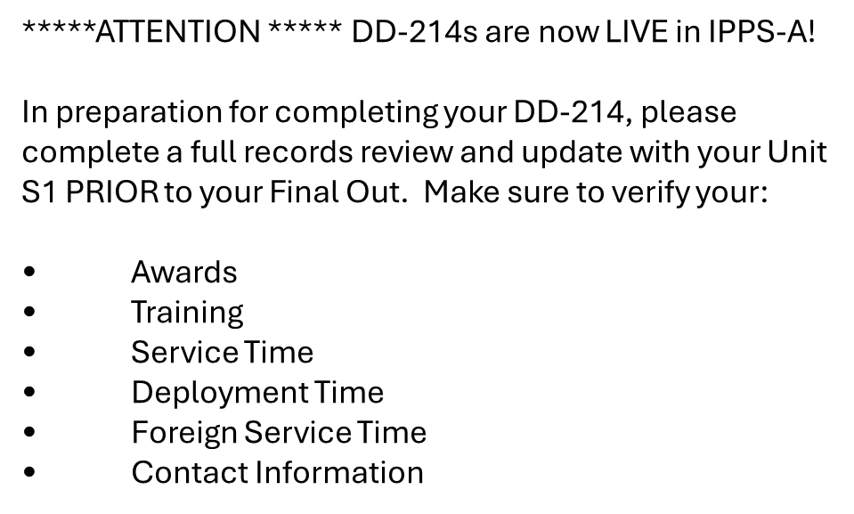

Slide 7
You’re almost done with the process!
After your DA Form 199 is approved by the Physical Disability Agency (PDA), your name will be added to the Notification Roster, stating that you have been approved for discharge. This process may occur within 24 hours or up to 3 weeks.
We will contact you when your name appears on the Transproc List
From the date you are placed on the Notification Roster, you will have a window of 90 days to be completely out of the military. Fort Carson Policy is 56 days. Twenty-six days to be cleared and out of the Army and if taking leave thirty days of terminal leave.
Notes:
Soldier signs DA199 and will appear on the Transproc list within 2-3 weeks after signing DA199. SFAC will notify soldier when they hit the list and will inform the to go to Transitions for their orders.

Slide 8
TIPS FOR PLANNING AHEAD
  Is your chain of command going to grant you PTDY and how much? 10 or 20 days? Active Duty only, USAR/NG Not authorized, unless called to AD for more than 1 year.
  Consider selling some leave. You can only sell a max of 60 day in your career.
  Is your CIF turned in? In no, please ask your CoC for an early turn in memo. CIF turn in outside of PCS season is 4-6 weeks out for an appointment.
  Living in on-post housing or renting? 30-day notice to vacate.
  Are you shipping anything through JPPSO? You must have your orders to set up JPPSO. (7-14 days out to pick up HHG). JPPSO Bldg. 1525 (Mountain Post Soldier Center) (526-3755). You must sign up on: move.mil, if you are using any form of JPPSO services.
  Start or complete the Transition Assistance Program (TAP) NOW!
  The Army’s goal for the Transition Phase of IDES is to have you on leave or separated within 26 days of the notification. There is a high probability you will be on transition leave the “NEXT MONTH”, after signing the DA Form 199
Notes:
Things soldiers need to plan for

Slide 9
Two Important Documents:
Orders and DD-214
Company
Personnel Files
IPPS-A (Transitional Leave)
DD Form 93
(Emergency Data Card)
NCOER/ OER /Final Award/s
SGLI
These documents reflect the accuracy of your orders and DD-214. Please update IPPS-A & your SRB.
Enlistment Contract
Reenlistment Contract
Current LES
Updated SRB
Deployment Dates/Orders
Prior DD 214’s
Certificates & Training
Notes:
Soldier need to have all this up to date and where to locate them to ensure their DD-214 is correct

Slide 10

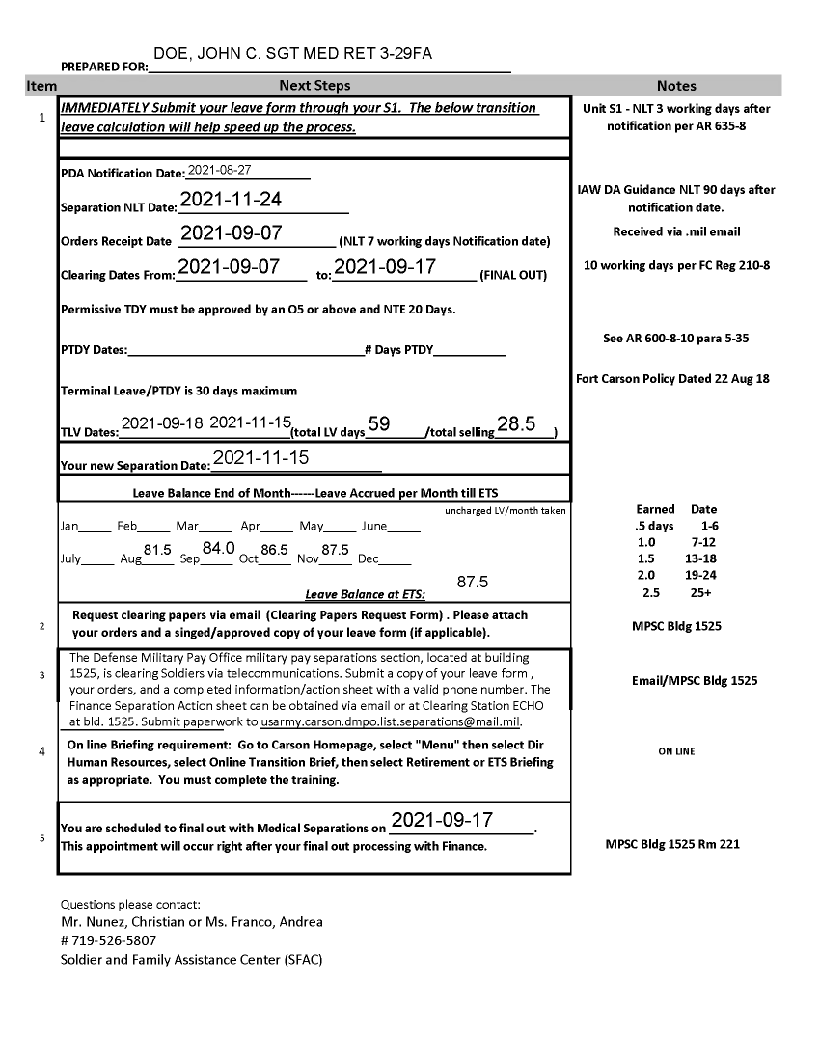



SFAC LEAVE CALCULATION
PDA NOTIFICATION- Date SM hit TRANSPOC Notification Roster
Final Out Day is the last day SM is at work. Last day in Uniform
SEPARATION NLT DATE - Last Day SM can be in the Army
Notes:
Key words soldiers should be familiar with for their transitions out of the Army.

Slide 11
Example of Last Pay Schedule
If your Separation Date is 06/26/2024.
  Your last regular mid-month pay would be 06/15/2024
  Within 30-45 business days you will receive the first portion of your final Army pay due. This includes leave cashed and severance (if applicable), and any other active duty pay due NLT 08/29/2024.
  VA Pay should be paid the first of the following month 08/1/2024.
  *This is an estimate. If you are having pay issues call:
  VA: 1-800-827-1000 (Comp & Pen issues)
  Local Finance: 719-526-9233 (Severance and Active Pay)
  DFAS: 1-800-756-4571 (Retirement Pay & SBP)
Notes:
Example of what their pay will look like

Slide 12
Final Active-Duty
Military Pay
12
Finance final-out processing: Once you have your orders and approved signed Leave Form, go to the Finance Section (Cube D) in Bldg. 1525 and attend the mandatory briefing M, T, W, F @1000
Your final active-duty military pay will be direct deposited into the same account you currently have on your date of separation. Finance recommends to not close your account for at least 1 year after your DOS. If you have questions contact 719-526-9233, or DFAS (www.dfas.mil)
Final pay includes base pay, authorized allowances and any unused accrued leave; minus deductions
Month of separation LES IS NOT accurate. DFAS will generate a correct LES approximately 45-60 DAYS AFTER DOS
Have a financial plan! Emergency fund in case payments are late!
Consider selling some leave if you are concerned about gaps in pay. This will only be your BASE PAY.

Slide 13

Travel
If you are moving away from Fort Carson, you may request advance travel pay.
See JPPSO located in the Mountain Post Soldier Center, Bldg. 1525
YOU MUST HAVE ORDERS!!!
Full Government move and/or partial DITY
DITY
  Keep all receipts of travel (e.g., lodging, weight tickets)
  7-14 days for pickup of HHG.
  KEEP ORIGINAL DOCUMENTATION WHEN SETTLING TRAVEL VOUCHER
  Not moving your things? Wagon Travel office (SRP) will purchase you a plane ticket home.
Notes:
Soldier must have orders to talk to JPPSO, even to ask general questions

Slide 14

Clearing
Fort Carson
Mountain Post Soldier Center Building 1525
  (Old Commissary, next to CIF)
TRANSITION LEAVE through IPSS-A and Orders
Begin no sooner than 10 Working days prior to leave starting
No leave form required if you are selling leave
Things you can clear early:
CIF (requires early turn-in memo from CDR)- call or schedule through AKO
TAP (must be complete prior to your final out date)
Notes:
Soldier will receive a Post clearing form along with a unit clearing form. SM does not have to pay off Star card. PX just needs a follow-on contact for the SM

Slide 15
Survivor Benefit Plan (SBP)
Military pay, including active duty pay and allowances and retired pay, stops upon a Soldier's death. The Survivor Benefit Plan (SBP) is a program through which the Department of Defense provides monthly, cost-of-living-adjusted income to eligible survivors of Soldiers who die on Active Duty in the line of duty, including Reserve Soldiers and National Guard Soldiers who die on Federal Active Duty in the line of duty and Retired Soldiers who choose to continue participating in the program after they retire.
Notes:
Only for SM that are retiring. If they have dependents, they will automatically be enrolled unless is in person to sign they do no want it. If the Spouse is not present, the SM will need to turn in a DD2656 that has been notarized and signed by the Spouse. This must be turned in when they final out, or they will enroll and will have to deal with this once that are out with DFAS.

Slide 16
Survivor Benefit Plan (SBP)
Soldiers who retire due to a service-connected disability incurred while on active duty, whether Regular or Reserve, may participate in SBP.
Reserve and National Guard Soldiers may participate in the Reserve Component Survivor Benefit Plan (RCSBP) when they complete 20 years of qualifying service for non-regular retirement.

Slide 17
Final out
17
Finance (Cube D)-the day of your final-out if you are taking terminal leave
The day prior to your final-out/separation day if no leave
Ensure accuracy of your Severance Pay (finance)
No sooner than the business day before your leave begins
DEERS (SRP 207-209)
TRANSITIONS DD-214 (SRP Rm 221)
CAPS (Cube E)
Building 813, 3rd floor, drop off DD-214
Notes:
DEERS station is for them to track SM last day. Not to receive new ID cards.

Slide 18
DD Form 214
18
Check for accuracy before signing – Your personal responsibility!
DO NOT LOSE/ GIVE AWAY YOUR LAST COPY
Copies:
  #1 – Service Copy
  #4 – Member Copy; only copy that contains reason for discharge and Character of Service.
File your copies (1 & 4) in a safe place, Scan for secure Digital Storage/ Consider filing with the County/City Recorder, Colorado MVD (SRP) will store for free.
Replace missing DD Form 214 immediately upon loss by going to: http://www.archives.gov/veterans/military-service-records

Slide 19
Colorado Quality of Life
2025
SPC 4 years $36.44 per hour $69,960.84
SGT 6 years $41.06 per hour $78,835.08
SSG 10 years $46.46 per hour $89,195.64
SFC 16 years $54.33 per hour $104,304.84
CPT 8 years $66.94 per hour $128,528.16
CW3 20 years $69.99 per hour $134,364.84
LTC 20 years $92.40 per hour $177,444.96
COL 30 years $113.39 per hour $217,725.36
Notes:
Monthly pay broken into a 40 hour work week. Included Base Pay+BAH+BAS/160hrs.

Slide 20
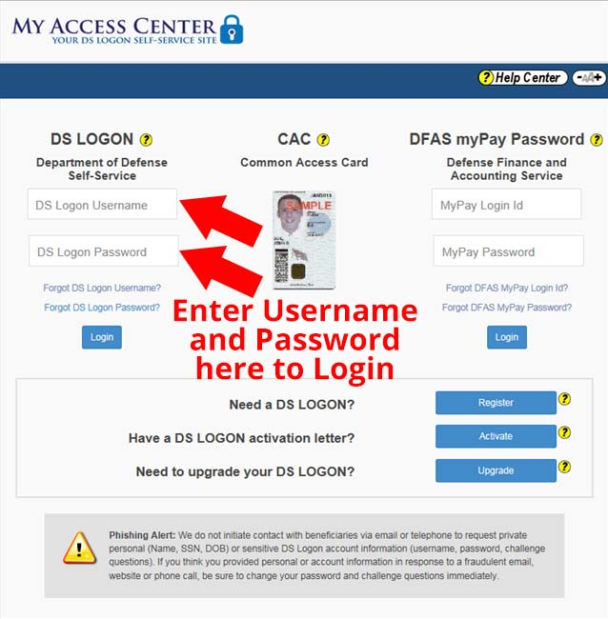
DS LOGON
A DS Logon is an ID issued by DoD that will let you access many VA and DoD sites with one user username and password. Sites and resources that accept DS Logon include eBenefits, Myhealthevet, TRICARE Beneficiary Web Enrollment (BWE), MilConnect.
https://myaccess.dmdc.osd.mil/identitymanagement
USE YOUR CAC TO ESTABLISH THIS PASSWORD BEFORE
YOU COME OFF ACTIVE DUTY
ENSURE YOU HAVE A PASSWORD FOR MYPAY
Notes:
This will allow them to also access their Army account once they are out.

Slide 21
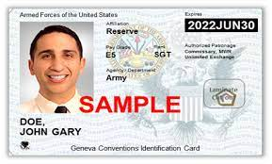
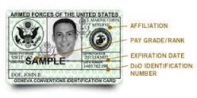
ID card upon Discharge/ETS
Visit nearest ID Card facility: https://rapids-appointments.dmdc.osd.mil/
Retiree-ID up to your 65th birthday
TDRL-ID for 3 yrs
Separating-ID for 2 yrs (Commissary/PX/MWR)
6 months free medical care, must sign up with TRICARE
Use VA Health ID to Access military installations (must register card)
You can only obtain new ID Card(s) on or after the
day of your Discharge/RET date
Documents needed for your ID Card: Two forms of valid ID, DD 214 and Discharge Orders
Notes:
Earliest they can receive their ID cards is their Separation date.

Slide 22

ENROLLING IN TRICARE FOR RETIREES
  Beneficiary Web Enrollment (BWE) has moved: BWE is now inside milConnect. Inside milConnect, choose "Benefits" and then choose "Beneficiary Web Enrollment (BWE)" to access BWE. https://milconnect.dmdc.osd.mil
  Must be completely off Active Duty to enroll. If you do not enroll you and your family are ONLY eligible to use ER at MTF.
  Call your regional contractor
    East: 1-800-444-5445
    West: 1-844-866-9378
Notes:
If they cross the Mississippi river, they must call both East and West to set up their health care

Slide 23

Dental & Vision
23
TRDP will be replaced by the Federal Employees Dental and Vision Insurance Program (FEDVIP). FEDVIP offers a choice of 10 dental carriers. This is the same plan offered to Federal Employees and will result in more options for coverage
Enrollment is handled through BENEFEDS, which is the government-authorized and U.S. Office of Personnel Management (OPM)-sponsored enrollment portal
Visit https://Benefeds.com to review your enrollment options

Slide 24
Medical Care for Soldiers Medically Separating
If your Army disability rating is less than 30% you must apply for these temporary health plans upon separation:
Transitional Assistance Management Program
  No charge for 180 Days if using the MTF.
  May be subject to co-pays if using outside facilities
Visit www.Tricare.mil/tamp if you have questions
Options for family members after 180 days:
MEDICAID (Means-Tested)
Healthcare Exchange- HealthCare.gov
Employer Based Coverage

Slide 25
CHAMP VA
To be eligible for CHAMPVA, you cannot be eligible for TRICARE, and you must be in one of these categories:
The spouse or child of a Veteran who has been rated 100% permanently and totally disabled for a service-connected disability by a VA regional office.
Notes:
Only if they are not medically retired and are 100% Permanent and Total on their VA rating

Slide 26
Combat Related Special Compensation (CRSC)
A special compensation for combat and training related injuries that allows for concurrent receipt for soldier with less than 20 years of service.
Apply as soon as official VA rating is received
  Contact Wounded Warrior Project (WWP) for assistance on application:
  Matt Haley
  mhaley@woundedwarriorproject.org
  ACS every Tuesdays 09-1600
For more info: https://www.hrc.army.mil/content/CRSC%20(CombatRelated%20Special%20Compensation)
Notes:
All medically retired under 20 years need to apply to receive some of their Army retirement pay back

Slide 27

VA/DOD Liaison Program (SFAC): 2025
Once you sign your DA Form 199, you need to see VA to enroll in the VA Health Care System. VA will need a copy of your signed 199, NARSUM, and VA Ratings.
Establish Primary Care and/ or Mental Health Services anywhere in the United States. VA care is Free for Veterans with a VA rating at or above 50%.
If your less than 50% you pay small copays of $15 outpatient or $97 inpatient care for nonservice connected injuries and care is free. if the injury is service connected.
VA Healthcare Liaisons
  Brian Murphy, LCSW
  Tina Randall, LCSW

Slide 28

Filing a claim for disability compensation or increase disability compensation with the VA
You can support your VA disability claim by providing these documents:
VA medical records and hospital records. These could relate to your claimed illnesses or injuries or they could show that your rated disability has gotten worse.
Private medical records and hospital reports. These could relate to your claimed illnesses or injuries or they could show that your disability has gotten worse.
Supporting statements. These could be from family members, friends, clergy members, law enforcement personnel, or people you served with. These statements could tell us more about your claimed condition and how and when it happened or how it got worse.
Notes:
Only for those that are not 100% with the VA do we recommend to apply if they have more claims to file.

Slide 29
VA Education Benefits
Chapter 31
Specifically for vocational rehabilitation, while Chapter 33 is for the Post-9/11 GI Bill.
Chapter 35
The Survivors' and Dependents' Educational Assistance Program, Chapter 35, provides education and training opportunities to dependents of veterans who are permanently and totally disabled with a VA rating of 100% due to a service-related condition, or who died while on Active Duty.
https://www.va.gov/education/how-to-apply/
Fort Carson Education Center: Building 1117 (719) 526-2124
Notes:
CH 35 100% Permanent and Total on their VA rating only can kids and spouse use.

Slide 30
Life Insurance
You will no longer be eligible for the SGLI after you are out of the Army.
Veterans’ Group Life Insurance (VGLI)
You can get between $10,000 and $500,000 in term life insurance benefits. The amount you’ll get will be based on how much SGLI coverage you had when you left the military.
When you leave the military, you can sign up through VGLI for coverage up to the amount you had through SGLI. You can also increase your coverage by $25,000 every 5 years—up to $500,000—until you’re 60 years old.

Slide 31
How VA Calculates Compensation Rates
If a Veteran has a 50 percent disability and a 30 percent disability, the combined value will be found to be 65 percent, but the 65 percent must be converted to 70 percent to represent the final degree of disability.
Similarly, with a disability of 40 percent, and another disability of 20 percent, the combined value is found to be 52 percent, but the 52 percent must be converted to the nearest degree divisible by 10, which is 50 percent.

Slide 32
Example of Combining Three Disabilities
If there are three disabilities ratable at 60 percent, 40 percent, and 20 percent, respectively, the combined value for the first two will be found opposite 60 and under 40 and is 76 percent. This 76 will be found in the left column, then the 20 rating in the top row. The intersection of these two ratings is 81. Thus, the final rating will be rounded to 80%.

Slide 34
Questions
Contact the SFAC ACS Specialist at
(719) 526-5807
To contact us by email please visit: https://carson.armymwr.com/programs/soldier-family-assistance-center

